Slide 1
Rental Home Hunters
Olisa Nwora

Slide 2
Project Objectives
This dataset will be used to view, compare, and predict statistics based on common factors.
Identify Different Aspects: Identify the types of rooms getting booked & the price they are booked for.
Comparisons: Discover how much a room type is on average and compare it to the other room types. See as to how many days are available out of the year compared to the pricing.
Predict: Make an educated prediction on the likely-hood of a certain room type being available within the year. (Likely or unlikely) Then make an estimate on the average price of stay based on the room type.

Slide 3
What is it?
Private Room- When you book a private room, you'll have your own private bedroom for sleeping but will share some spaces with others, like the host or other guests. (AirBnB)
Entire Home/Apt- Guests will have the whole place to themselves, including a private entrance and no shared spaces. An entire place usually includes a bedroom, a bathroom, and a kitchen. (AirBnB)

Slide 4
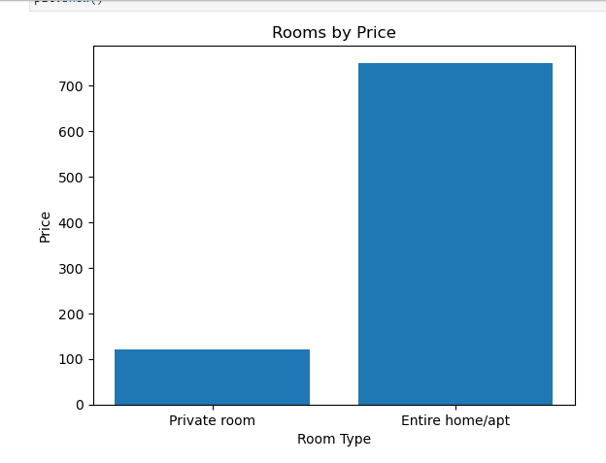
Rooms by Price
It can be clearly seen that the price of a private room will be much less compared to a home or apartment.

Slide 5
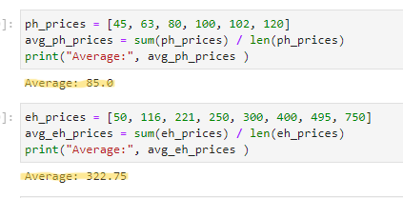
The average nightly price for a private room is $85. The prices for this type don’t range to heavily. An entire home/apt prices at an average of $322, with the highest being $750 per night. This is understandable given the range of entire home sizes.

Slide 6
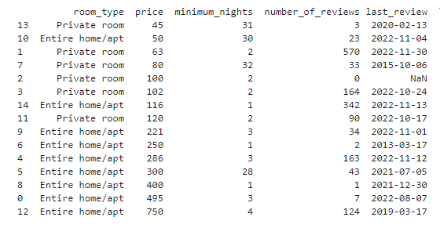























Comparisons

Slide 7
In the previous slide, the two lowest costing homes are opposite types of each other. Both have a month’s long minimum stay and are fairly the same price. Private Room is $45 whereas the Entire Home option is $50. The only difference is the number of reviews and when the last review was received.
- The Private room has a mere 3 reviews with the last one being over 2 years ago
- The Entire Home/Apt has 23 reviews with the last one being only 7 months ago.
The significance in this is that it seems entire homes/apts do better for long term stays whereas customers will prefer a more affordable for when it comes to quick trips.

Slide 8
Conclusion
In conclusion, based on number of reviews and minimum number of nights, it can be seen which room type is favored. Findings show that popularity of home varies mostly on the time that will be spent in the home. For shorter stays, private rooms will be the ones that are likely booked with the exception of entire homes being booked by mostly larger groups. The average price for a private room and entire home will more than likely drop from the current $85 and $322 to approximately $65 and $120 respectively in order for it to get booked.

